Slide 1


KH SYSTEMS Inc.
Company Profile

Slide 2
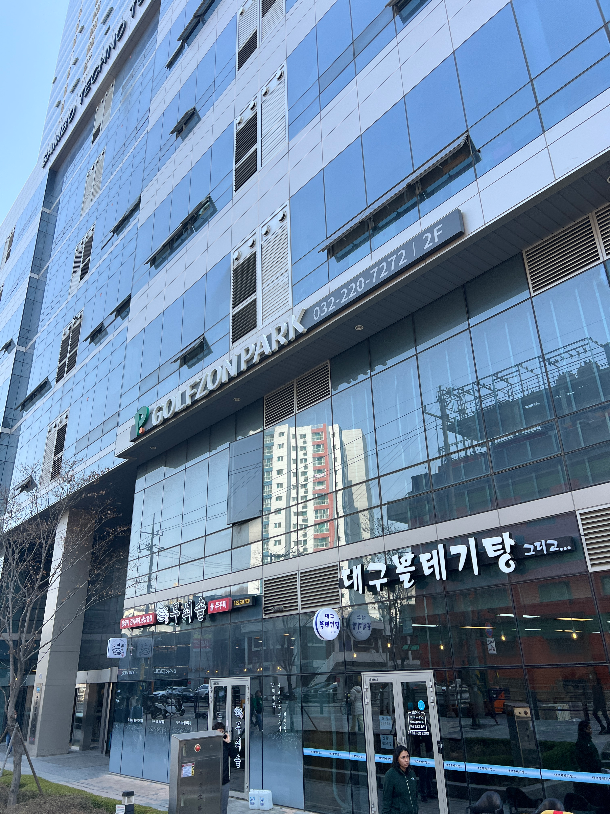
01
Introduction
Company Name
Company History
KH SYSTEMS Inc.
2018.05 Company incorporated
2021.02 Established dedicated R&D division
2021.06 Certified as a venture company
2022.05 Expanded Bucheon office
Date of establishment
2018.05.03
Head Office
E-802 30, Songdomirae-ro, Yeonsu-gu, Incheon, Republic of Korea
Buchoen Office
2705, 122, Jomaru-ro 385beon-gil, Wonmi-gu, Bucheon-si,
Gyeonggi-do, Republic of Korea

Slide 3




02
Development Business Areas
Elasticsearch
Factory Digitalization
XR
Other Business
Solution Delivery
Setup cluster
Index design
Licensing
Client Development
Java Elastic Client
Web Server Integration
FactoryManager Solution
MES/POP System
Sales order management
Purchase order management
Production order management
Inventory management
Labeling & Barcode
Label printing
Barcode scanning
Measurement Device Integration
Vernier calipers
Micrometer
XR Progamming Training
HoloLens Course
Unity Course
Speech VR Solution
Immersive speaking experience in VR
SubStation Monitoring
Real-time monitoring , analytics
Visual Dashboard
ESS Monitoring System
SMS alarm for Administrator
Data Ingestion to Big Data Platform

Slide 4
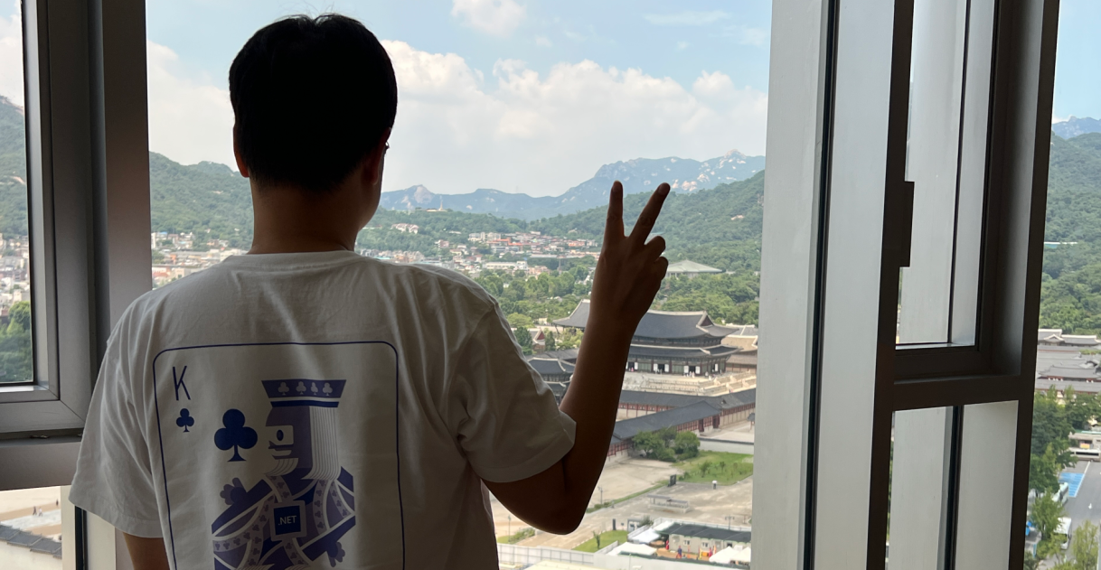
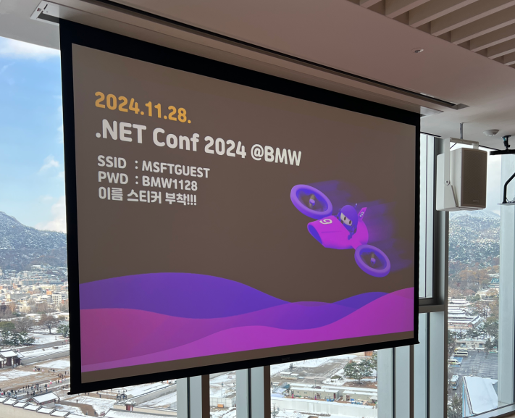

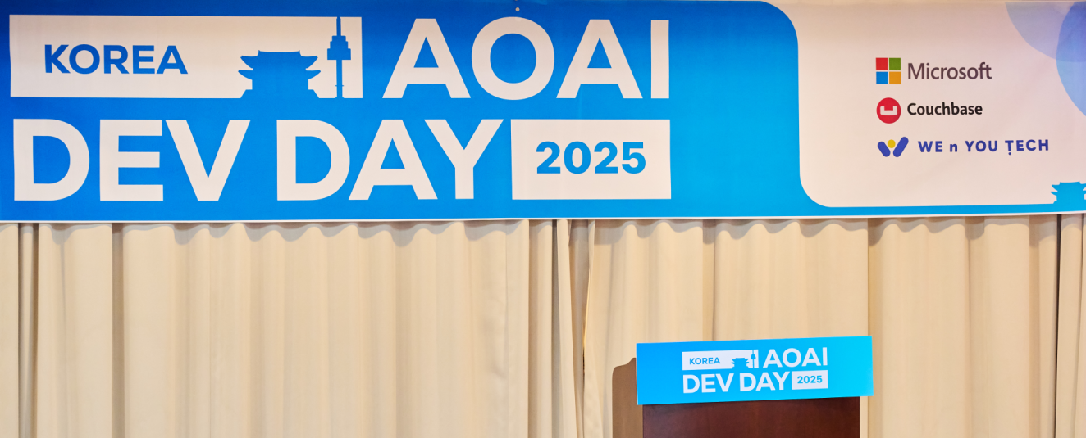
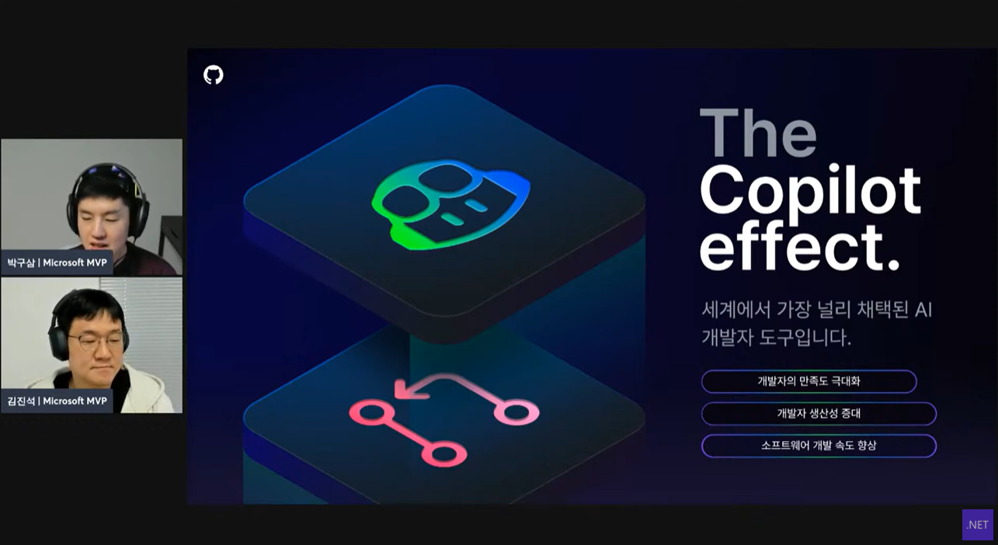
03
Community Areas
DevRel Member
Kim, JinSeok
President of KHSYSTEMS Inc.
Microsoft MVP (.NET / Azure AI Services)
.NET community dot4 Organizer
Major Event
.NET Conf
Local event for Seoul
Since 2023
.NET developer
DDD Seoul
Microsoft tech based conference
Since 2024
AOAI Dev Day KR
AI Conference for Azure OpenAI
Since 2025
AI developer
YouTube
Lets learn .NET – GitHub Copilot
.NET Aspire Series
Semantic Kernel Series

Slide 5
03
Community Areas
DevRel Member
Kim, JinSeok
President of KHSYSTEMS Inc.
Microsoft MVP (.NET / Azure AI Services)
.NET community dot4 Organizer
Major Event
.NET Conf
Local event for Seoul
Since 2023
.NET developer
DDD Seoul
Microsoft tech based conference
Since 2024
AOAI Dev Day KR
AI Conference for Azure OpenAI
Since 2025
AI developer
YouTube
Lets learn .NET – GitHub Copilot
.NET Aspire Series
Semantic Kernel Series

Slide 6
03
Community Areas
DevRel Member
Kim, JinSeok
President of KHSYSTEMS Inc.
Microsoft MVP (.NET / Azure AI Services)
.NET community dot4 Organizer
Major Event
.NET Conf
Local event for Seoul
Since 2023
.NET developer
DDD Seoul
Microsoft tech based conference
Since 2024
AOAI Dev Day KR
AI Conference for Azure OpenAI
Since 2025
AI developer
YouTube
Lets learn .NET – GitHub Copilot
.NET Aspire Series
Semantic Kernel Series

Slide 7















04
Clients

